Slide 1
How to set up a Developer Tenant for Power Platform
…because it shouldn’t be this hard.

Slide 2
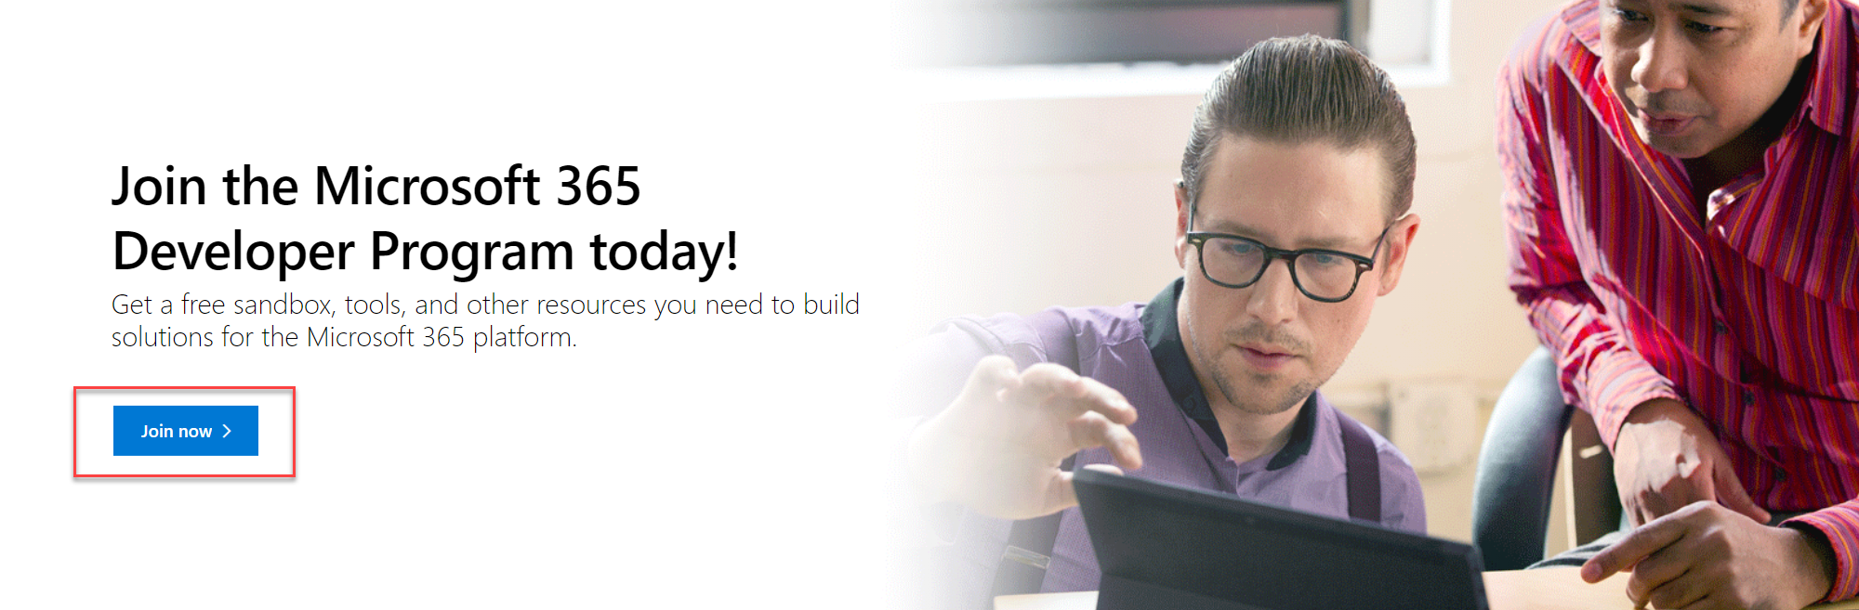
Join the M365 Dev Program
https://developer.microsoft.com/en-us/microsoft-365/dev-program

Slide 3
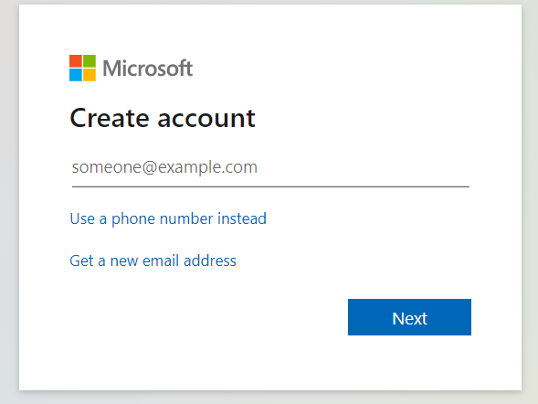
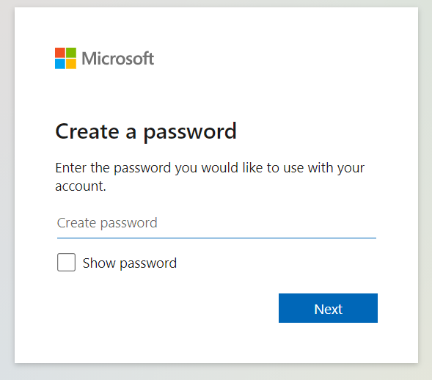
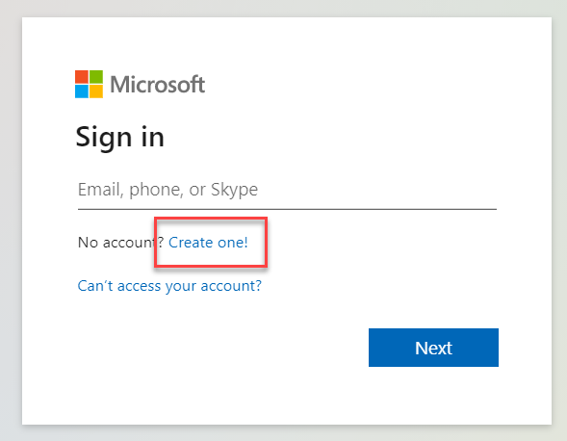
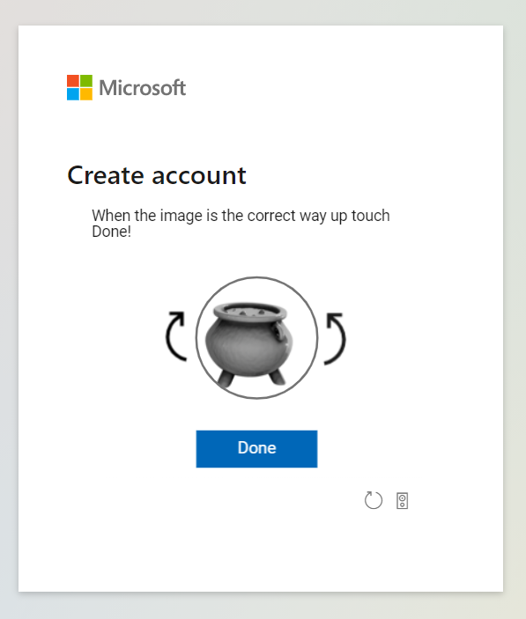
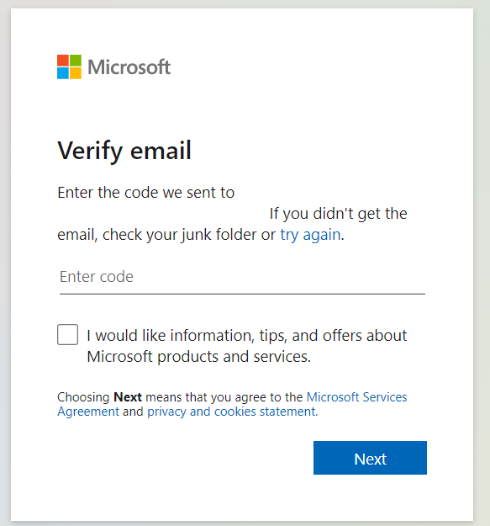
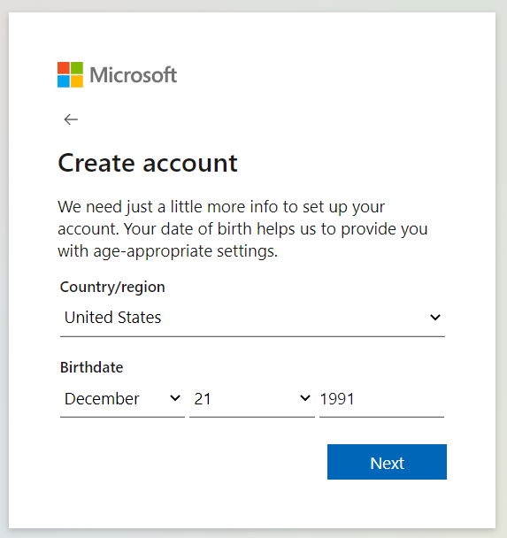
Create an Account

Slide 4
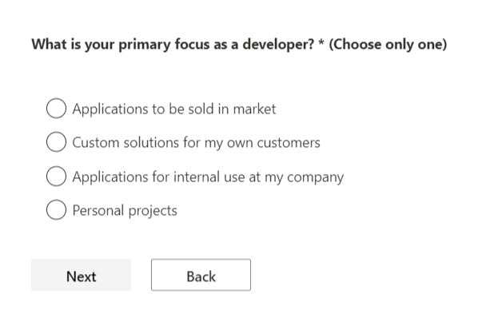
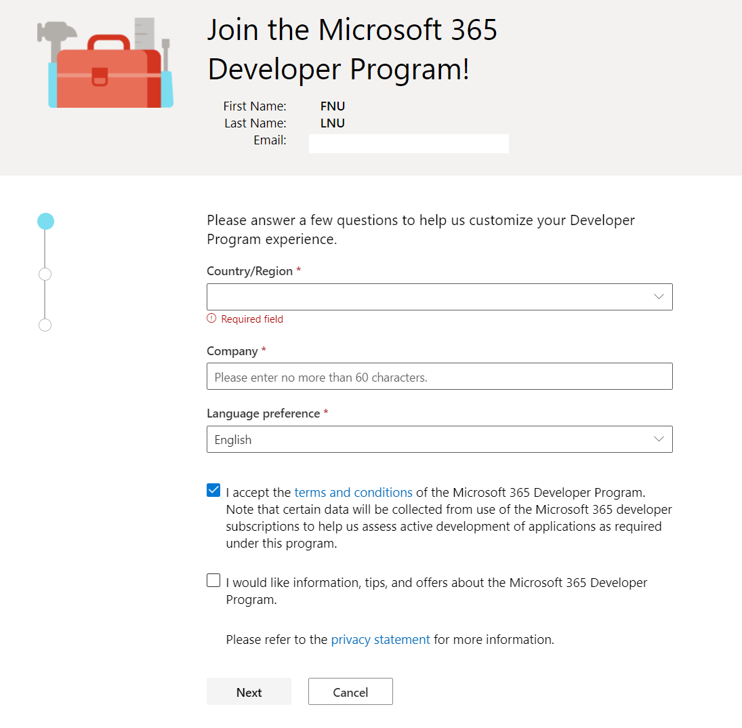

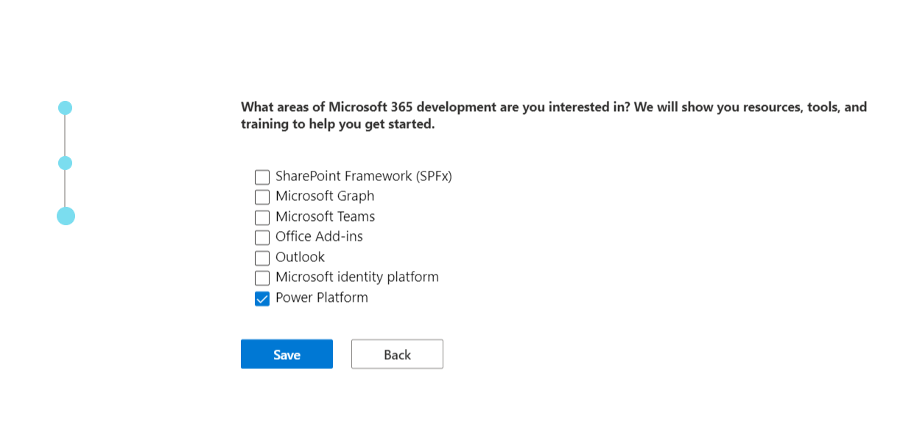


Fill in the form

Slide 5
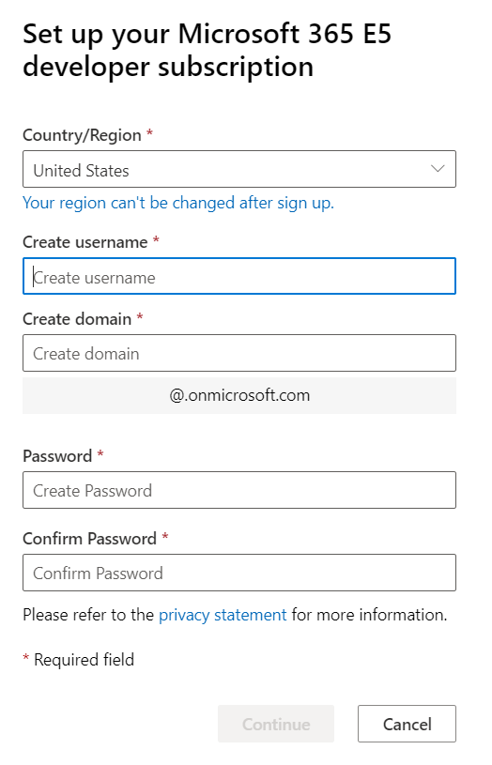
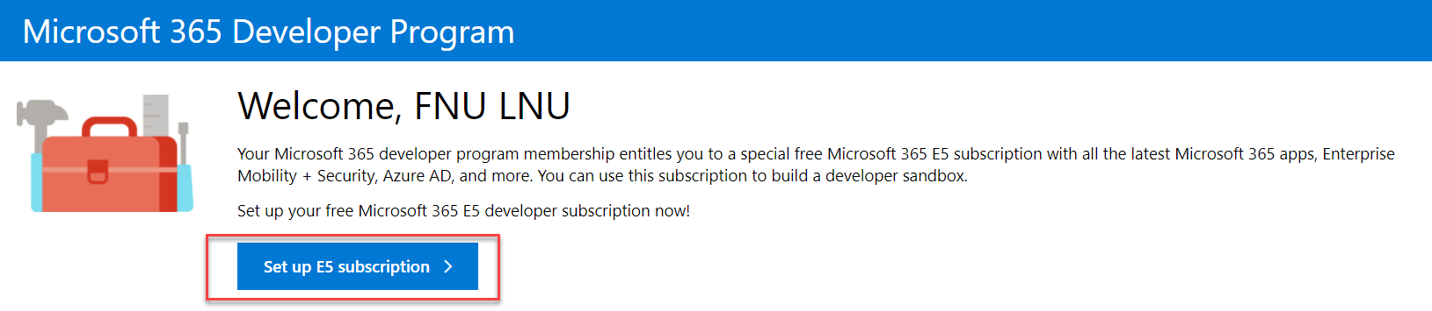
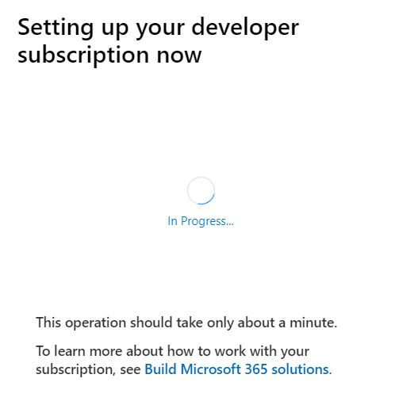
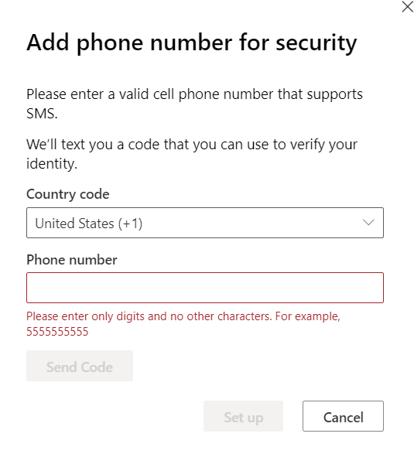
Set up the E5 Subscription
USE VALID PHONE NUMBER!

Slide 6
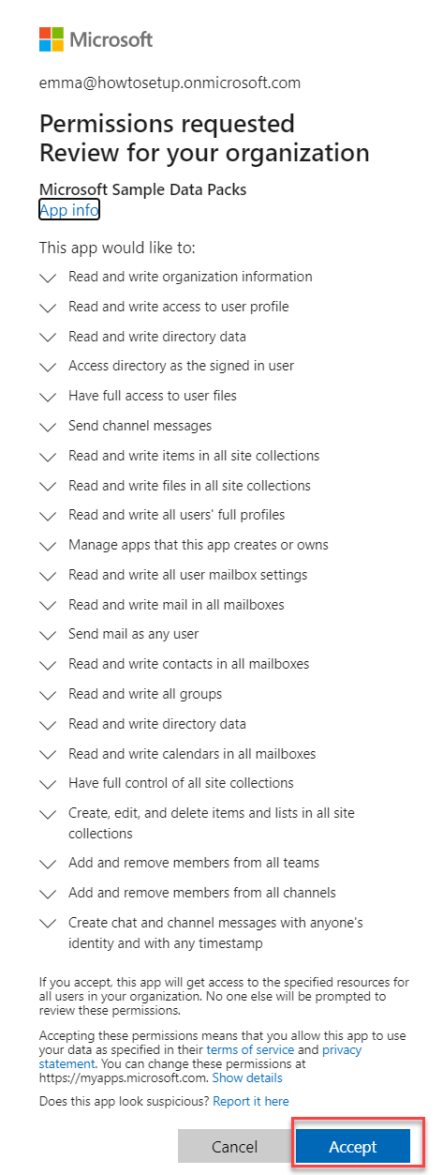
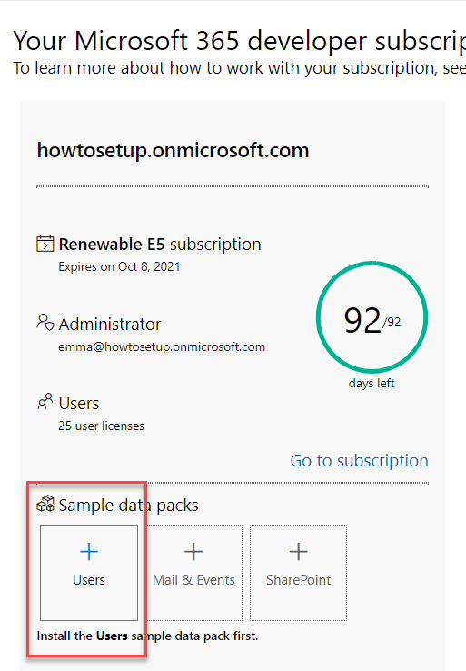
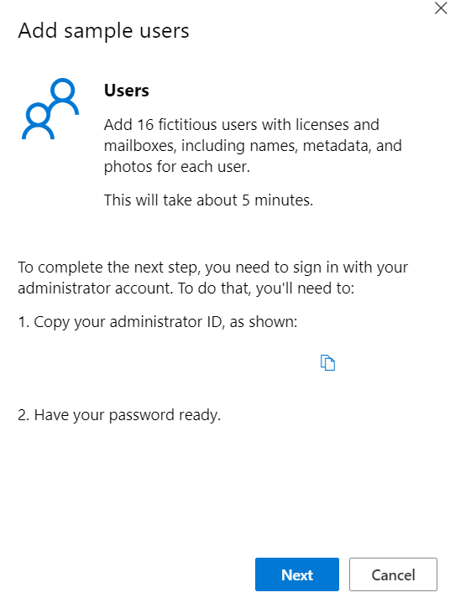
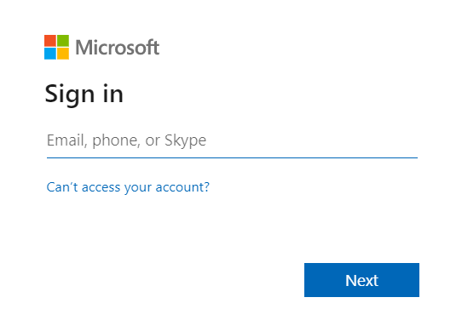
Go through the process steps - Users

Slide 7
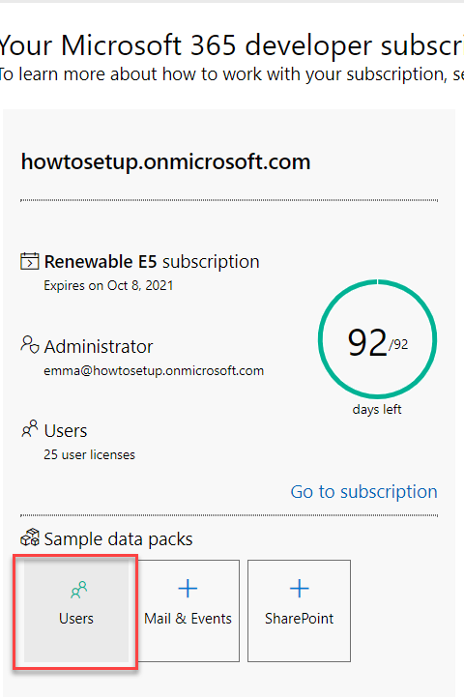
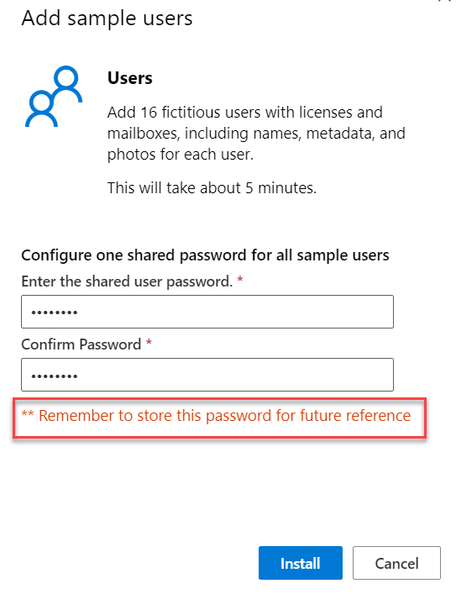
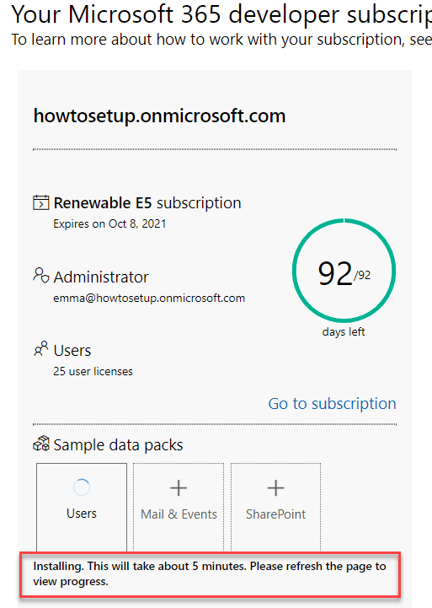
Go through the process steps - Users
You’ll get an email when the pack has installed

Slide 8
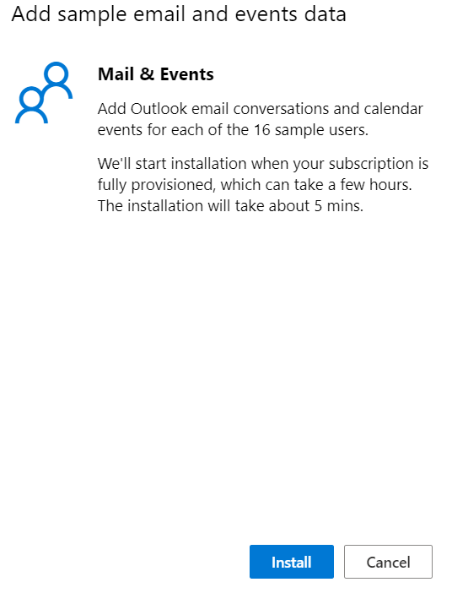
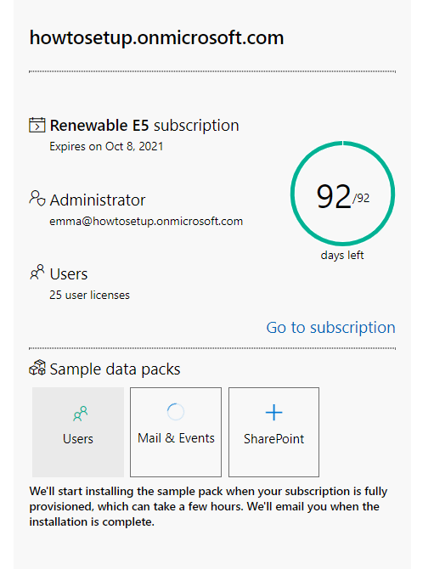
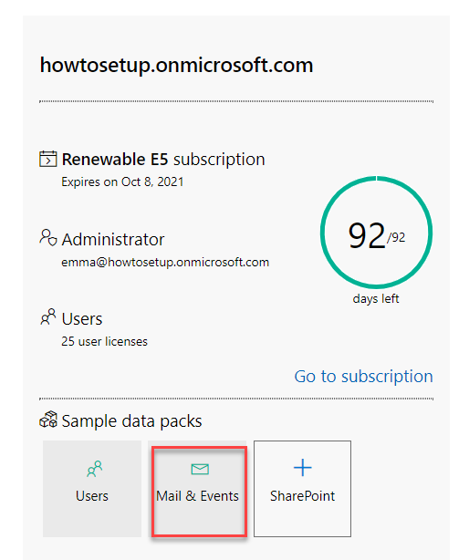
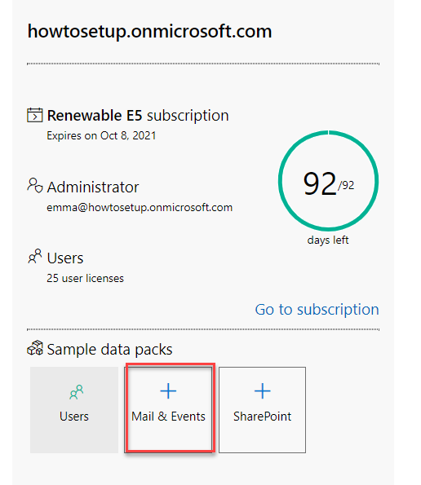
Set up Mail and Events
You’ll get an email when the pack has installed

Slide 9
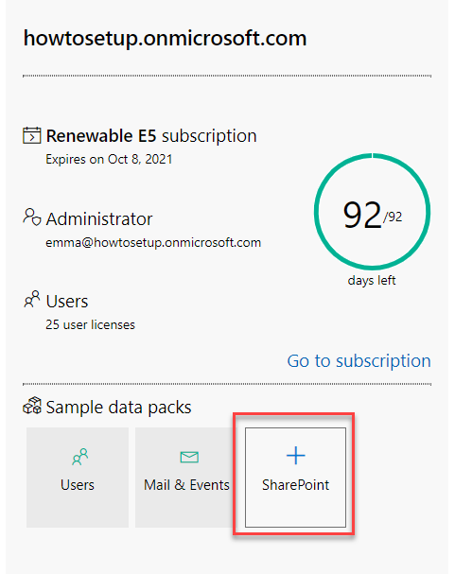
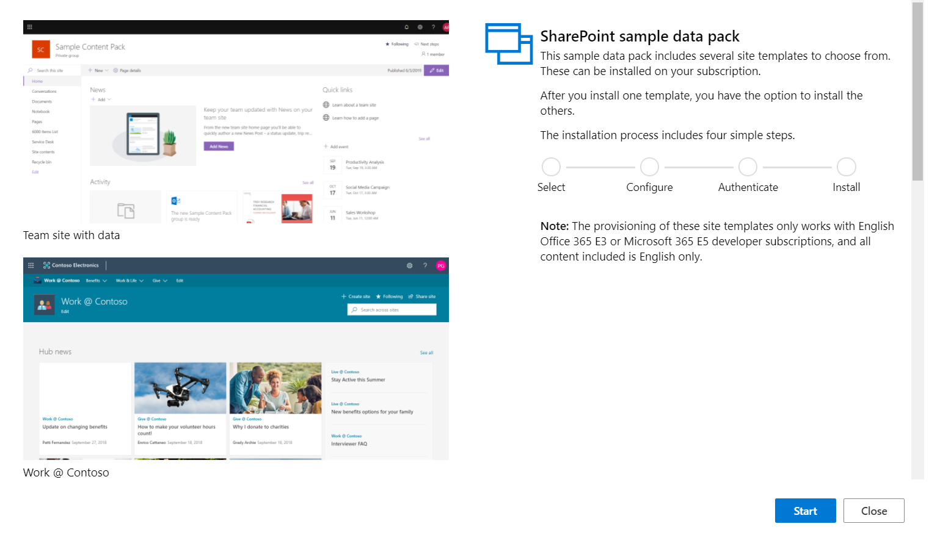


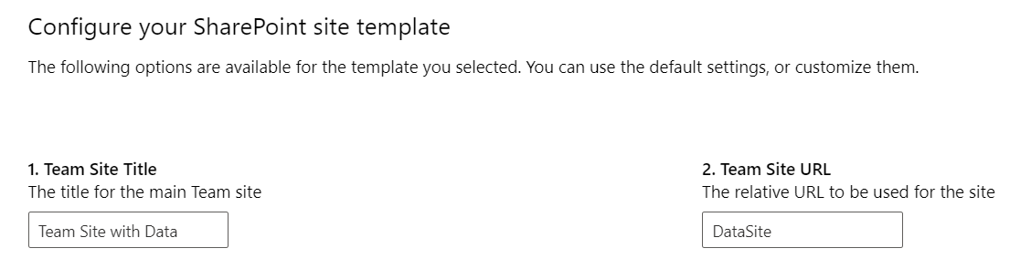
Set up SharePoint
Use the Team Site with Data for Power Apps dev
Can customize these or leave as is.

Slide 10
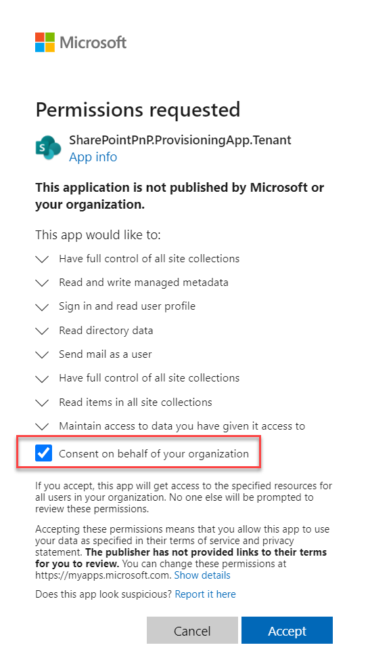
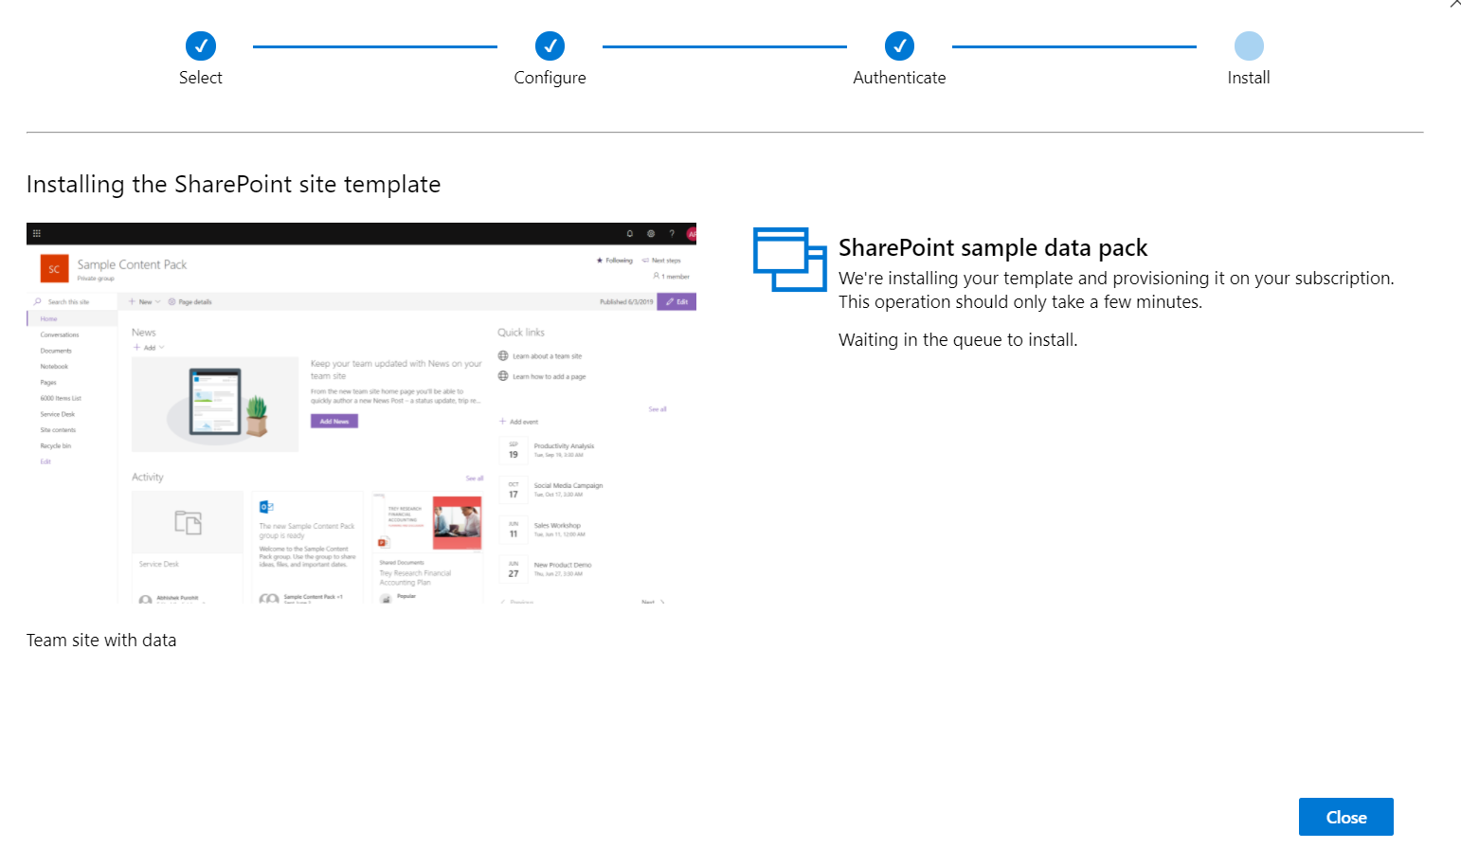
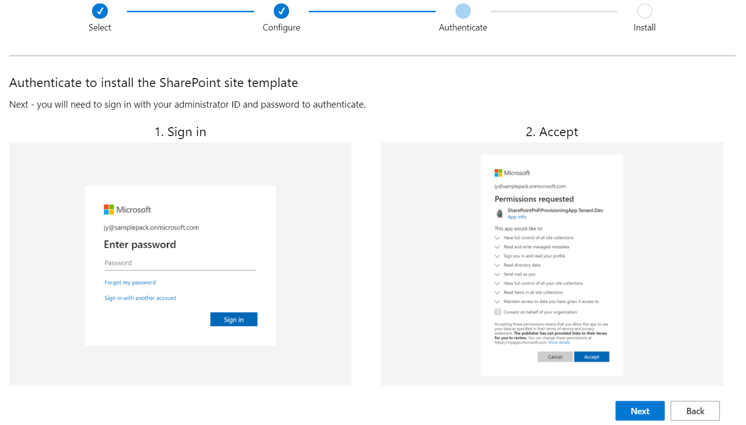
Set up SharePoint cont.
Click Close – the install will continue in the background. You will get an email confirming it has finished

Slide 11
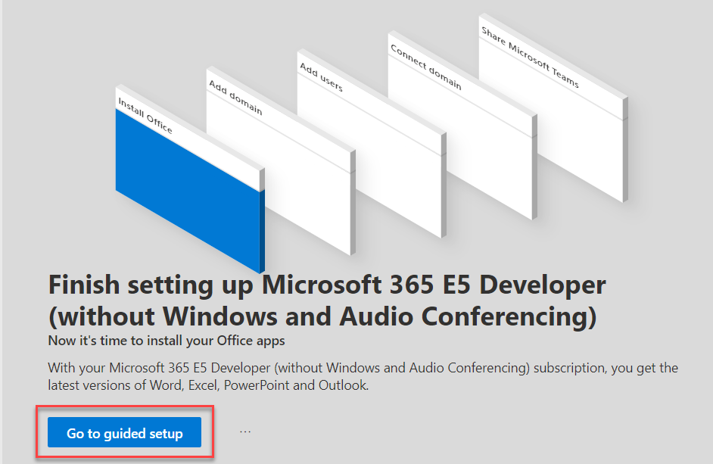
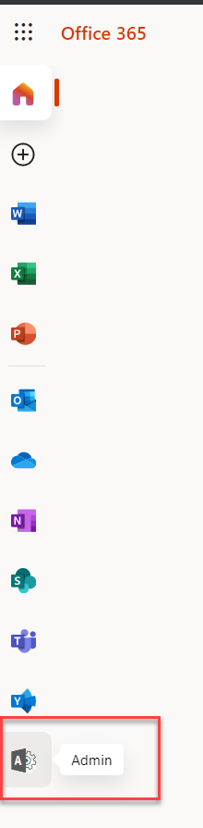
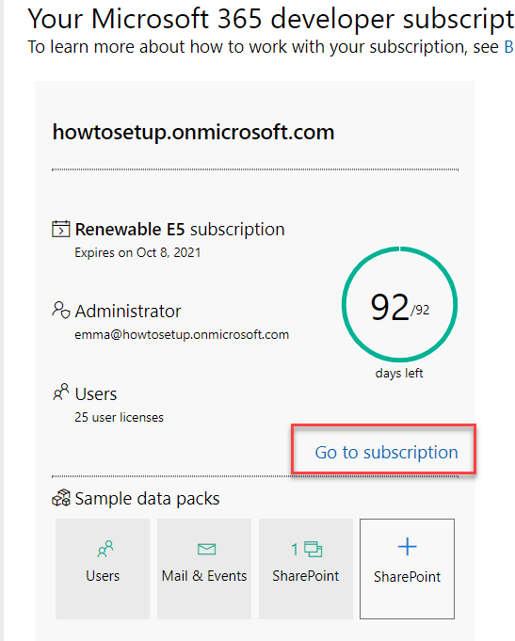
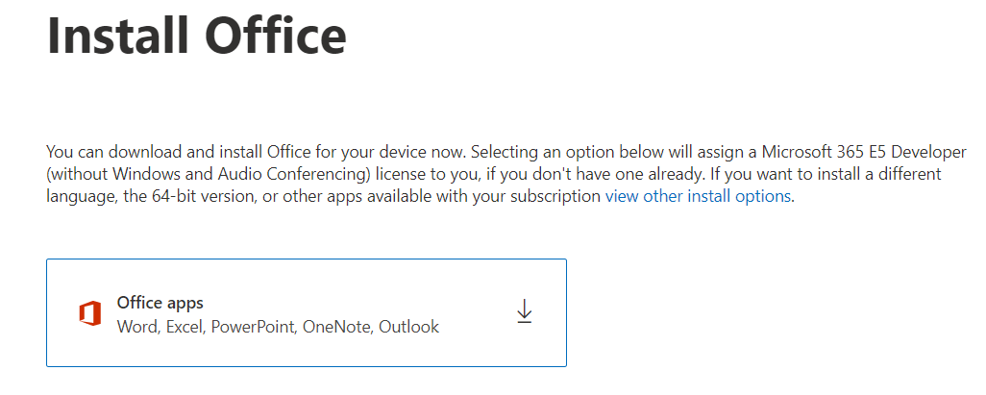
Set up the Subscription
OR:
https://admin.microsoft.com/
NOTE: THIS IS OPTIONAL! ONLY INSTALL IF YOU DON’T HAVE OFFICE

Slide 12
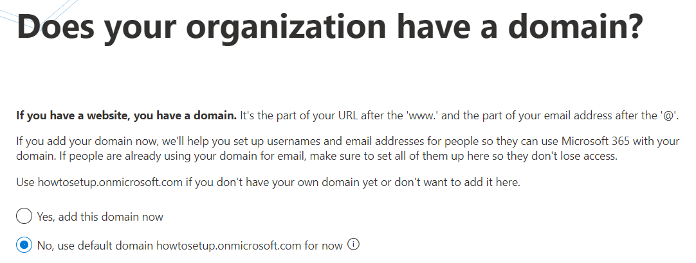
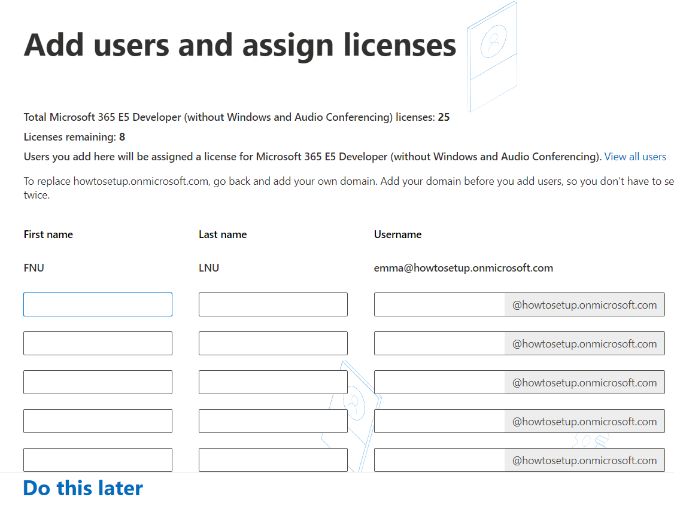
Setup cont.
Use default domain
Add more users or click Do This Later

Slide 13
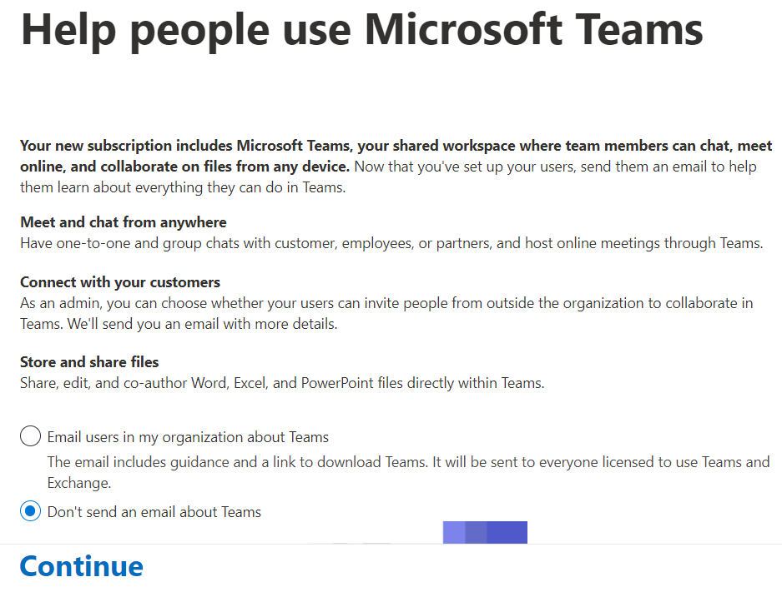
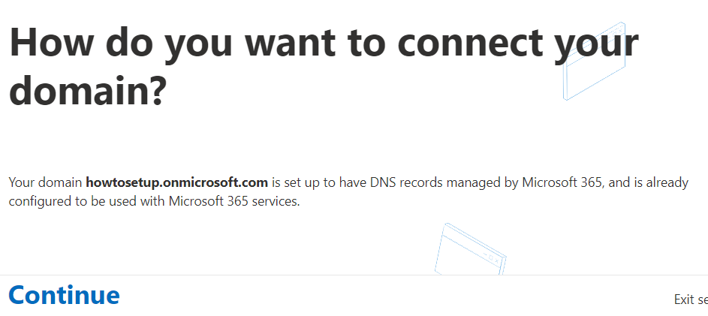
Setup cont.
Click Continue as we are using the default domain
Don’t send the email and click Continue

Slide 14
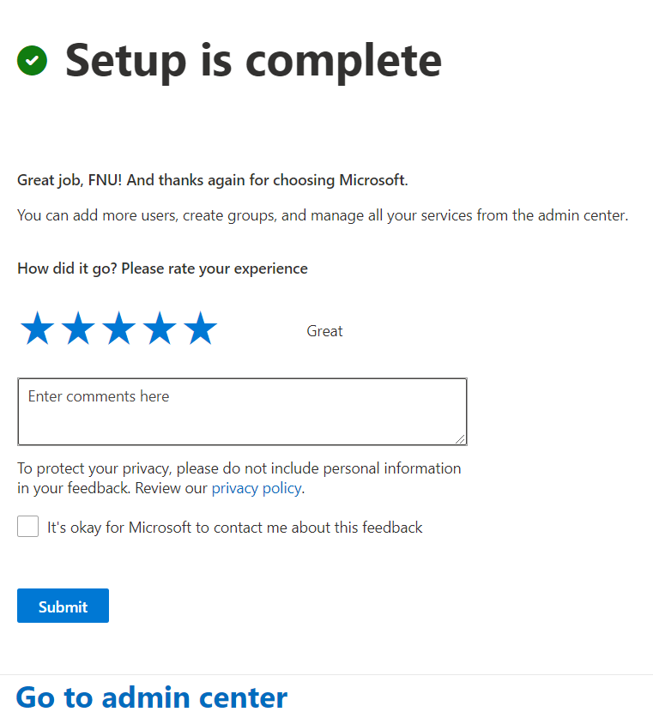
Setup cont.
Click Go to admin center! Now let’s get your Power Platform stuff set up!

Slide 15
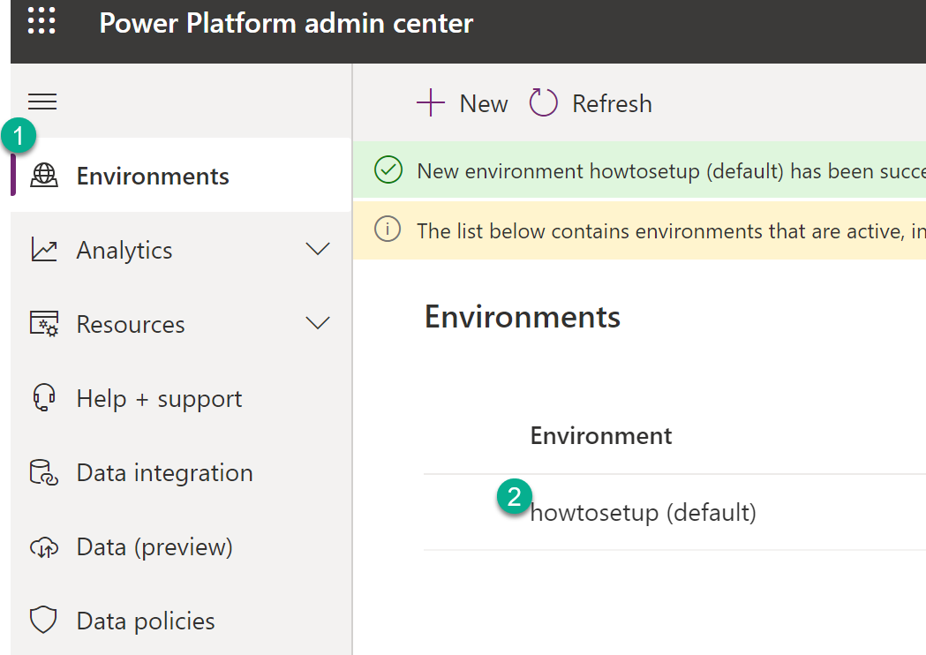
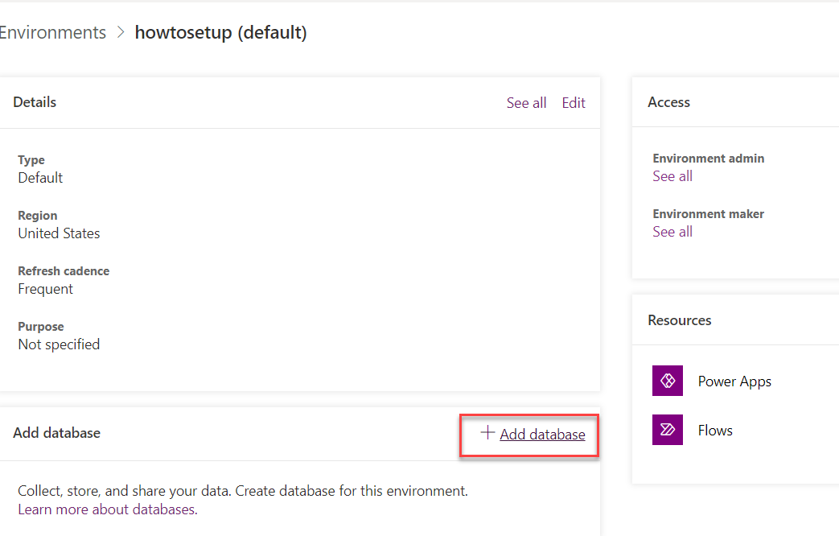
Adding a Database
Go to https://admin.powerplatform.microsoft.com/

Slide 16
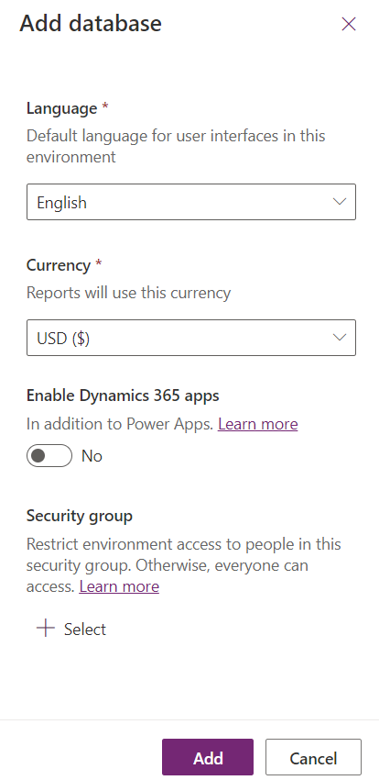
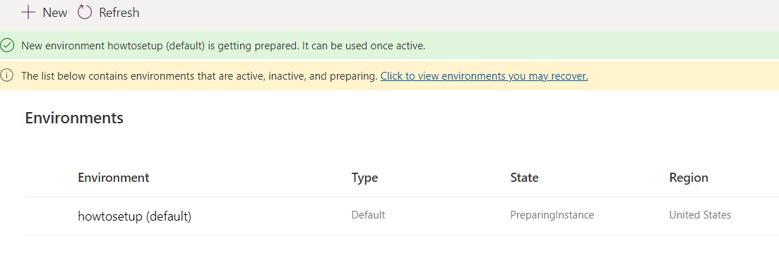
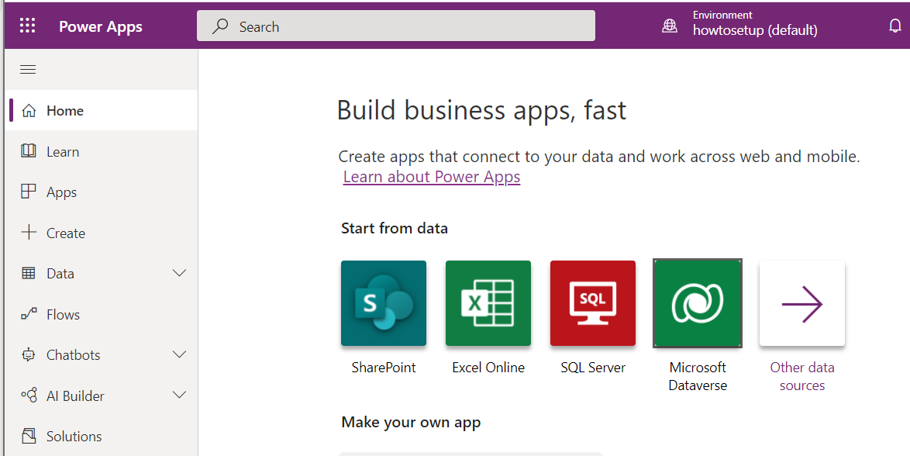
Adding a Database
Wait for it to finish provisioning. This may take 5 mins.
Set up your database as shown here.
Go to https://make.powerapps.com and START BUILDING!!

Slide 17
Beginner Resources
Udacity Course (Free) - https://www.udacity.com/course/microsoft-power-platform--ud091
Rory Neary - https://www.powerplatformlearn.academy/

