Slide 1





January 25, 2020
Microsoft Technology Center
Malvern, PA
Notes:
Philly text Requires this font: https://www.fontsquirrel.com/fonts/permanent-marker

Slide 2
Unified Interface
Breaking down the Controls!
Emma D’Arcy Philadelphia, 2020

Slide 3

Emma D’Arcy
Pre-Sales Engineer
@ ClickDimensions – 3 Years!
Charlotte, NC Chapter Lead
Blog: TattooedCRMGirl.com
Twitter: @TattooedCRMGirl
I like cats and video games!

Slide 4


Agenda
What is Unified Interface?
What are Controls?
Calendar Control
Linear Slider
Star Rating
Auto Complete
Radial Knob

Slide 5
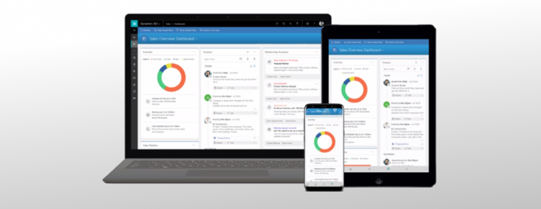
What is Unified Interface?
October 2020!
Same interface across multiple clients
Dynamics is broken into multiple model driven apps
Designed to be more accessible
Whole new look and feel – dashboards and controls

Slide 6
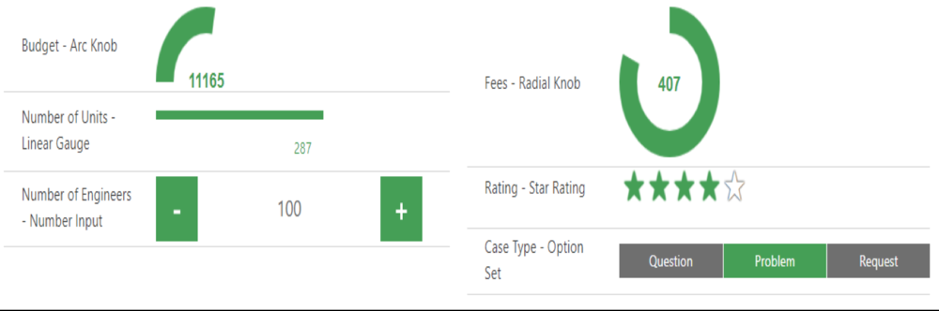
What Are Controls?
Visually Represent Data
Interactive!
Apply to a field, view or entity
Data Type Specific

Slide 7
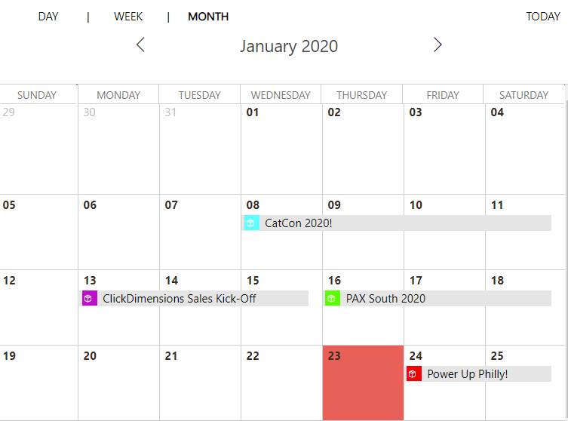
The Calendar Control

Slide 8
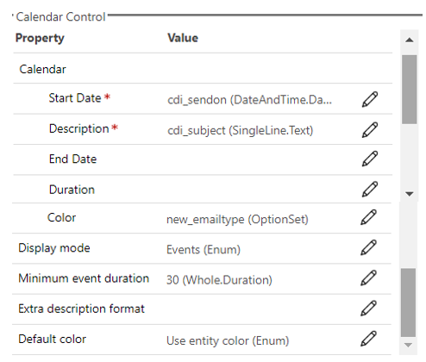
The Calendar Control
Applied to a View or an Entity
Displays records on a calendar
Can designate multiple options:
  Start Date
  End Date
  Description
  Colour (Option Sets)
  Duration (Consider End Date)

Slide 9
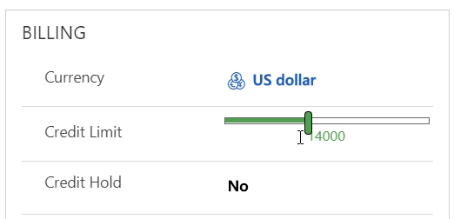
The Linear Slider

Slide 10
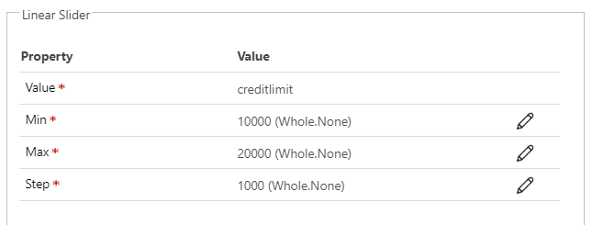
The Linear Slider
Applied to a field at the Form level
Numeric Fields
Can designate multiple options:
  Map to Numeric Field
  Min – Max Values
  Step – Incremental Values

Slide 11
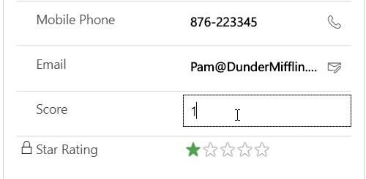
Star Rating

Slide 12
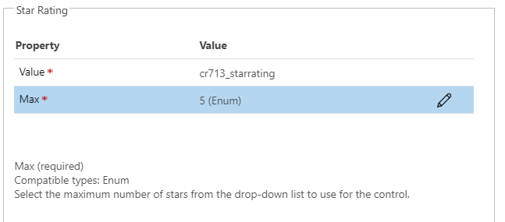
Star Rating
Applied to a field at the Form level
Whole Numbers Between 2 - 5
Not many customisations but lots of possibilities!

Slide 13
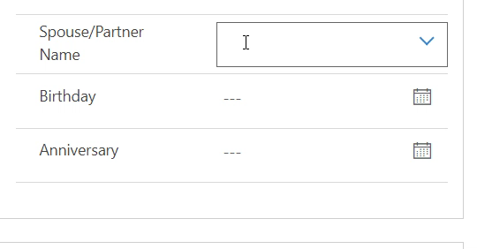
Auto Complete

Slide 14
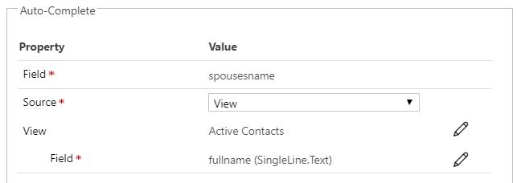
Auto Complete
Applied to a field at the Form level
Text Fields
Match against a view or option set.
Fuzzy Match!

Slide 15
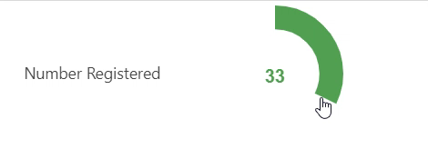
Radial Knob

Slide 16
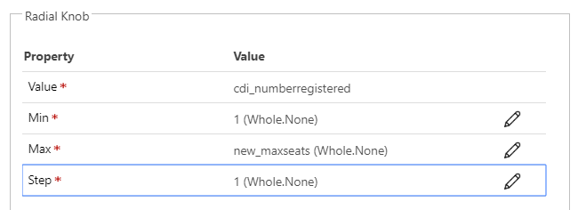
Radial Knob
Applies to a whole number field
On the form level
Can set Min/Max
Incremental Steps

Slide 17


Demo Time!

Slide 18

Questions?

Slide 19
Please thank your sponsors!
Notes:
Philly text Requires this font: https://www.fontsquirrel.com/fonts/permanent-marker

